Slide 1

Cryptography
CS-486
August 23rd, 2017 Paul A. Lambert

Slide 2
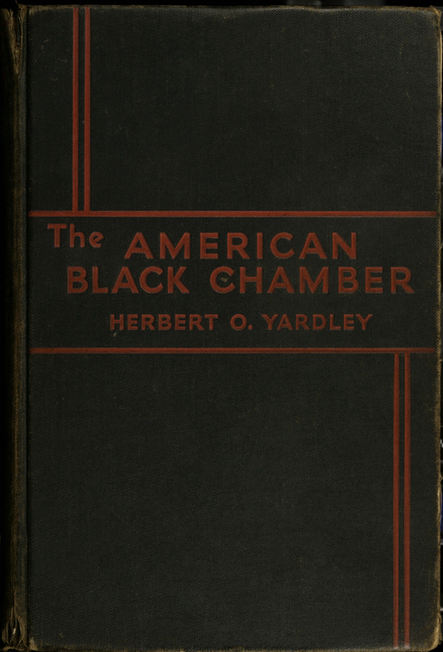
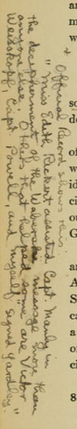
MI-8 operated 1917 to 1929 and broke German, Mexican and Japanese codes and ciphers.
The Secretary of State, State Henry L. Stimson, closed the group stating later in his 1947 biography, that: “Gentlemen do not read each other's mail.”
In 1931 the ex-head of MI-8 then exposed the work of the group in his book “The American Black Chamber”.
84 years later a copy of the book was released with margin note comments from the ‘dean of American cryptography’, William F. Friedman.

Slide 3
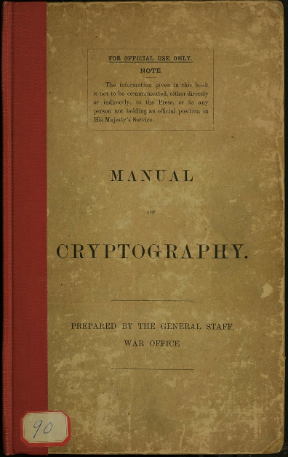
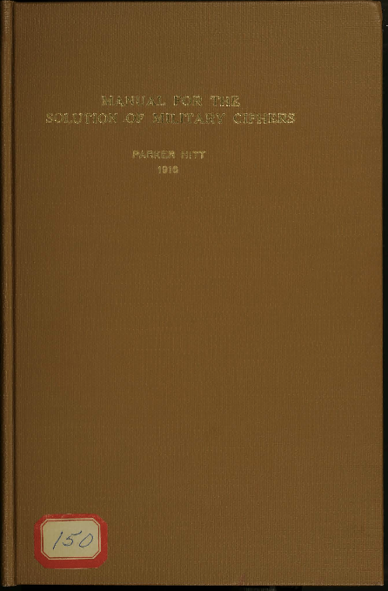
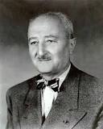
https://marshallfoundation.org/blog/friedman-collection-folger/
https://www.nsa.gov/news-features/declassified-documents/friedman-documents/

Slide 4
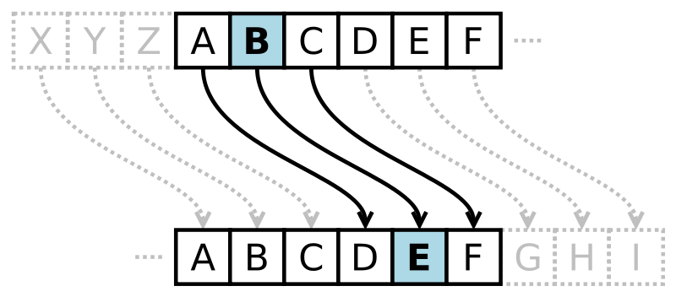
Caesar Cipher

Slide 5
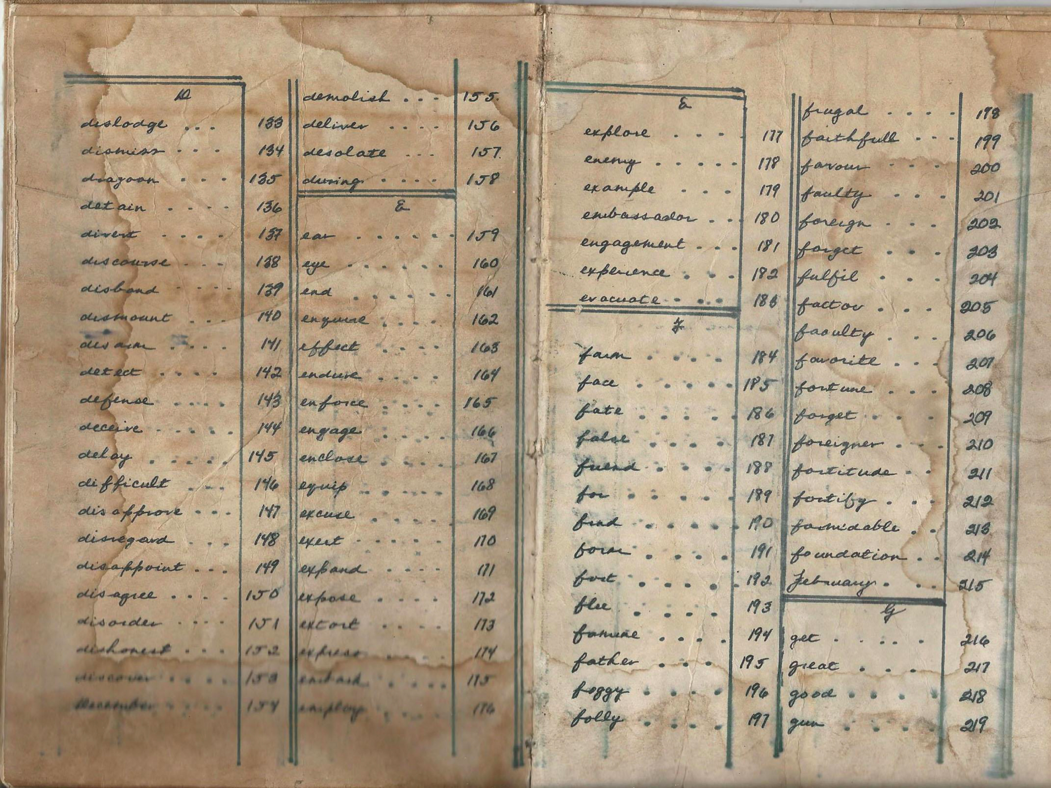
Codes

Slide 6
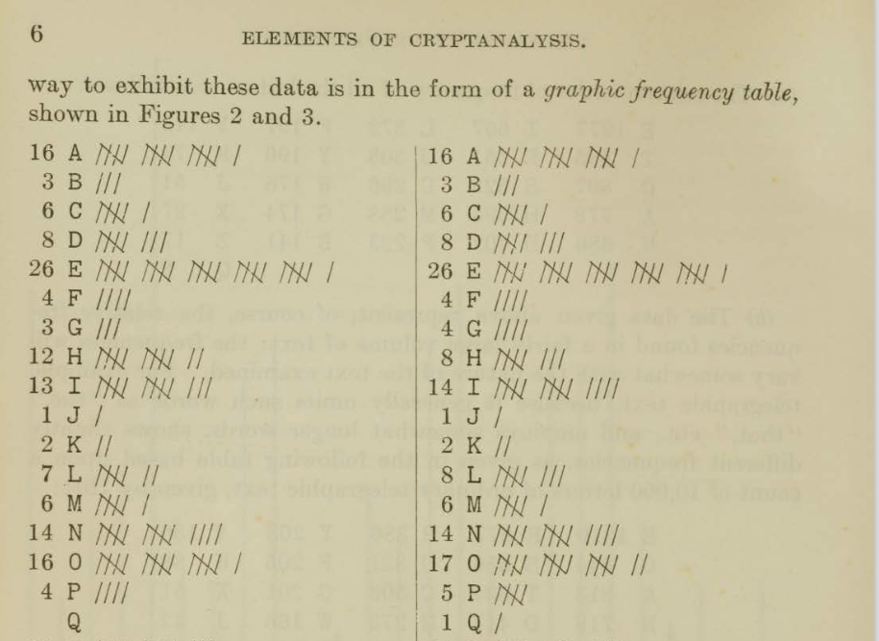
Cryptoanalysis

Slide 7
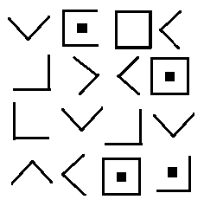
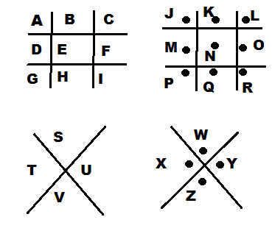
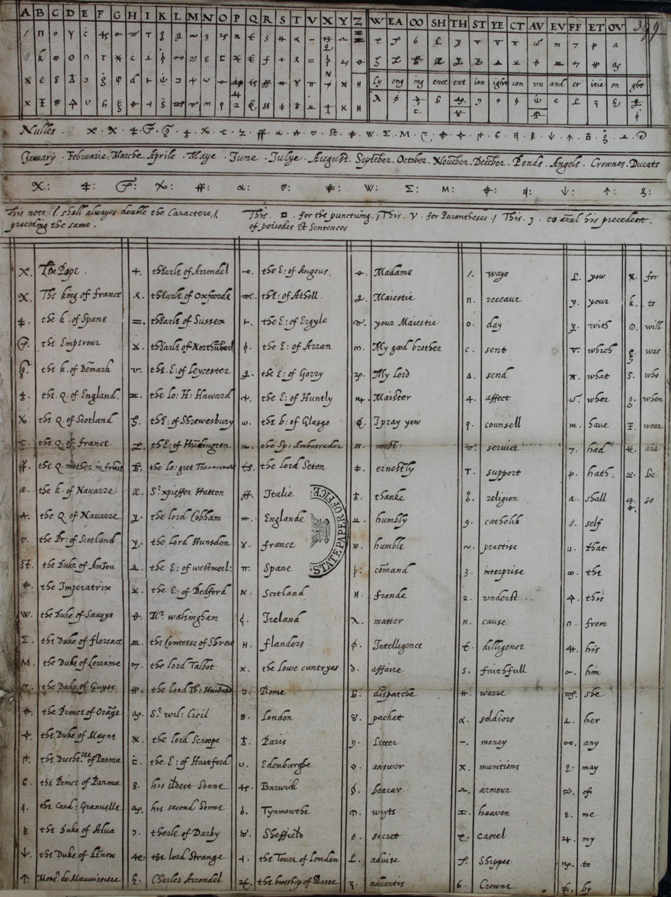
Alternate Alphabets

Slide 8
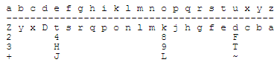
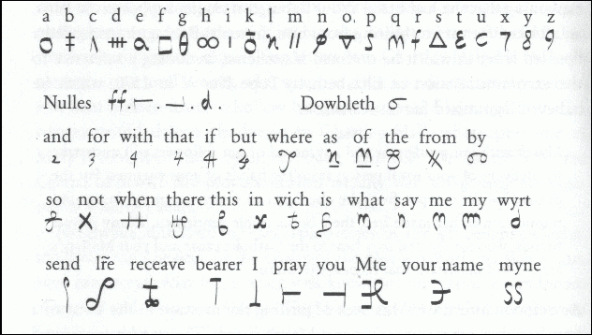
Homophonic and Nomenclators
1401
1587

Slide 9
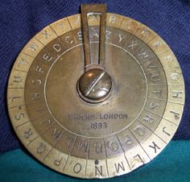
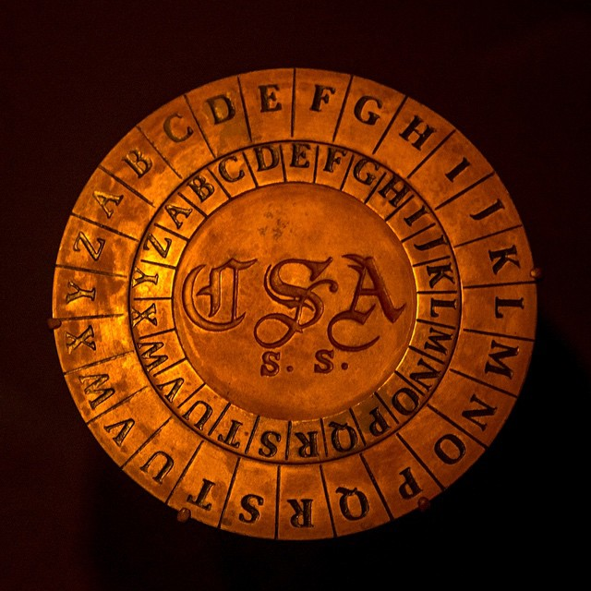
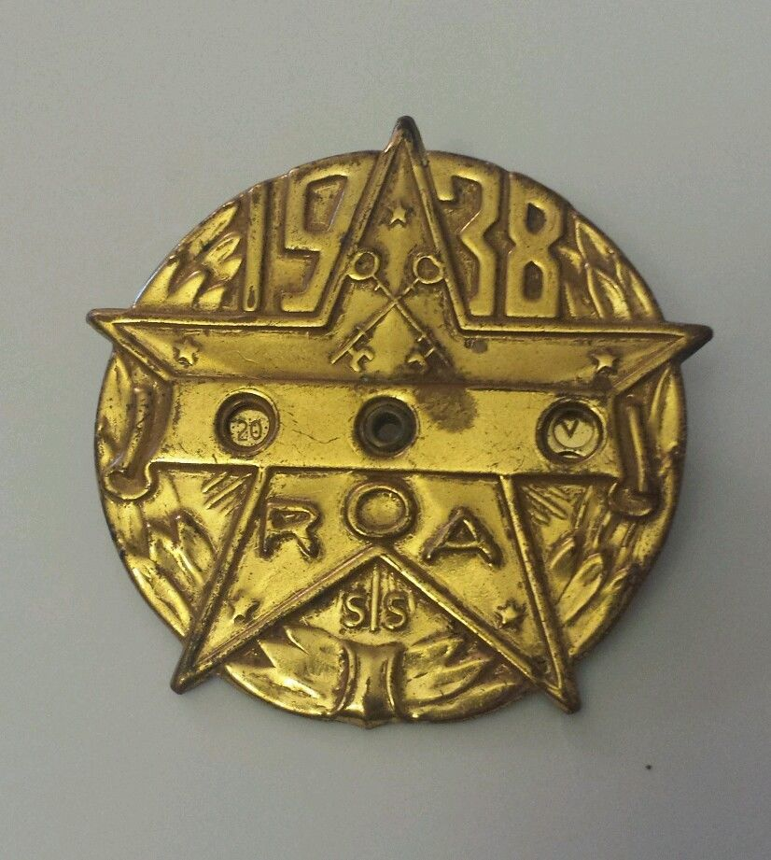
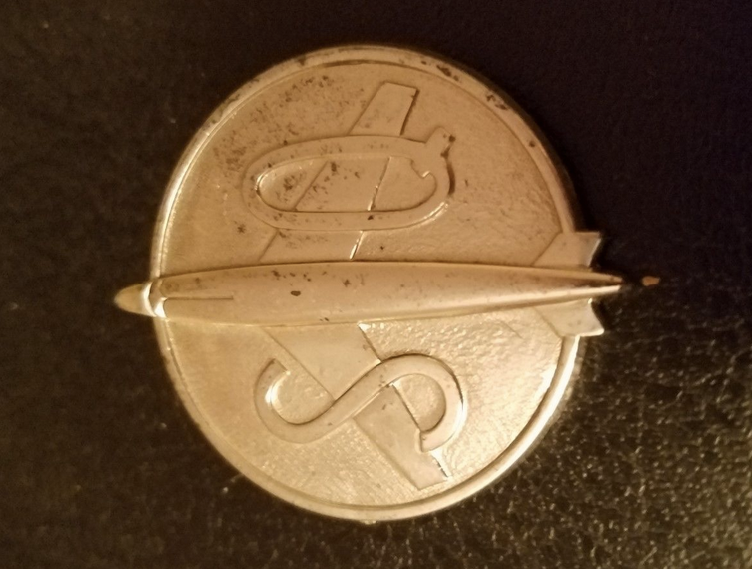
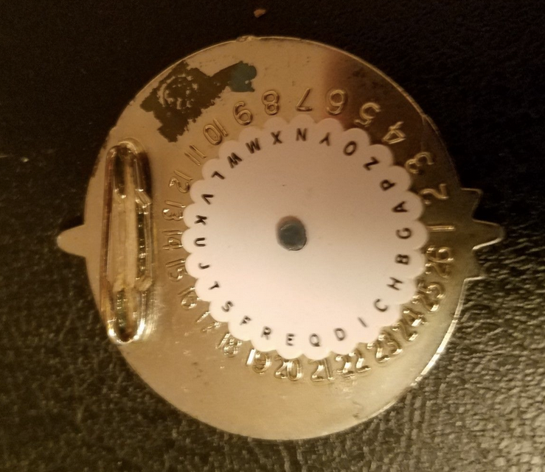
Code Wheels
3.8.18.7
7.5.2.5.4.1
8.9.5.3.8.5.22.7
APZOYNXMWLVKUJTSFREQDICHBG
https://archive.org/details/CaptainMidnight1955 (time 27:30)

Slide 10
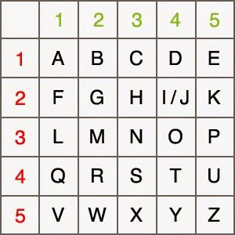
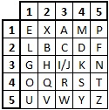
Polybius Squares

Slide 11
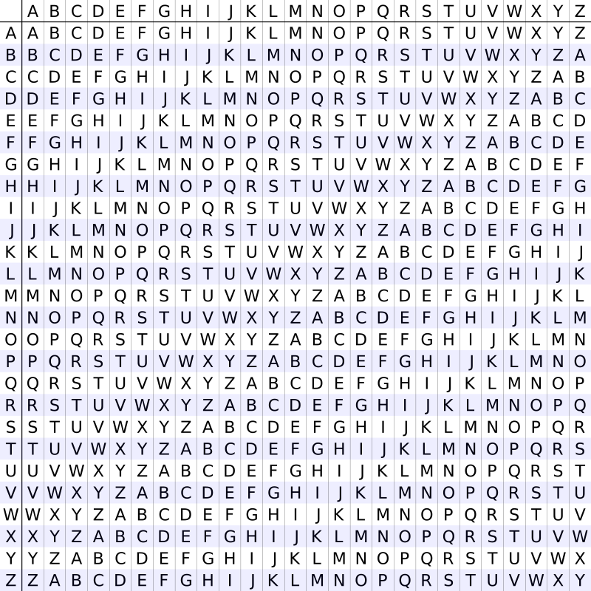
Vigenere Cipher

Slide 12
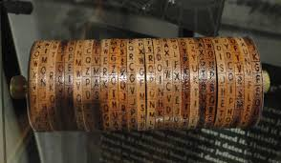
Thomas Jefferson’s Ciphers

Slide 13
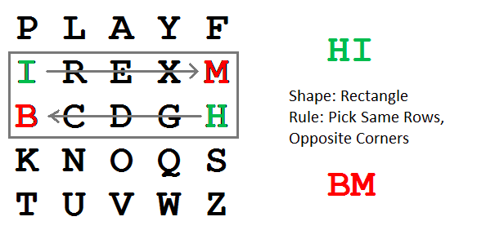
Playfair – a Digraph Cipher

Slide 14
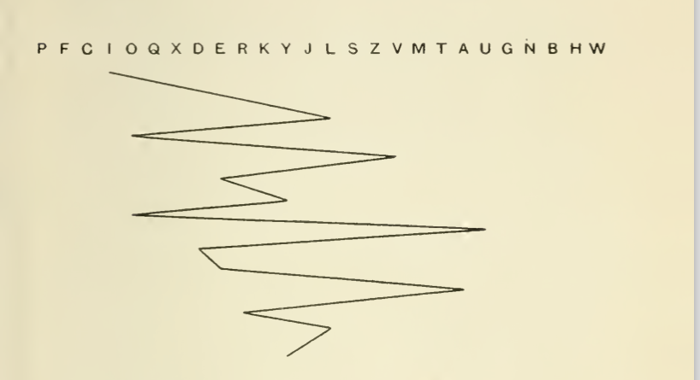
Zigzag

Slide 15
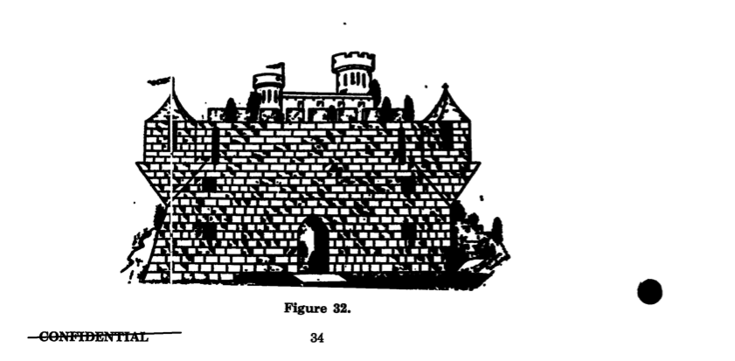
Steganography

Slide 16
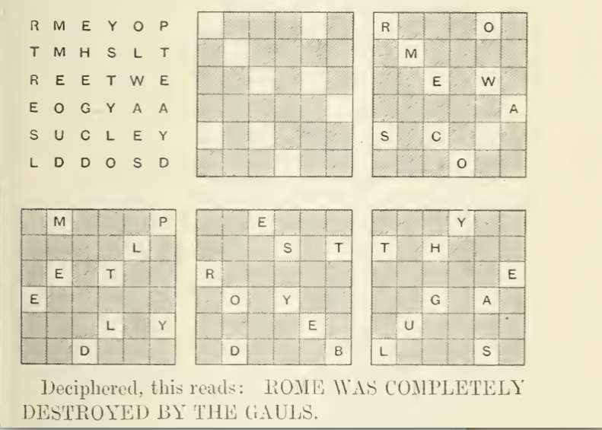
Grills
C22

Slide 17
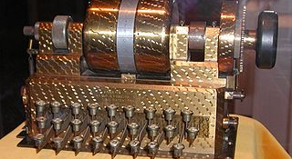
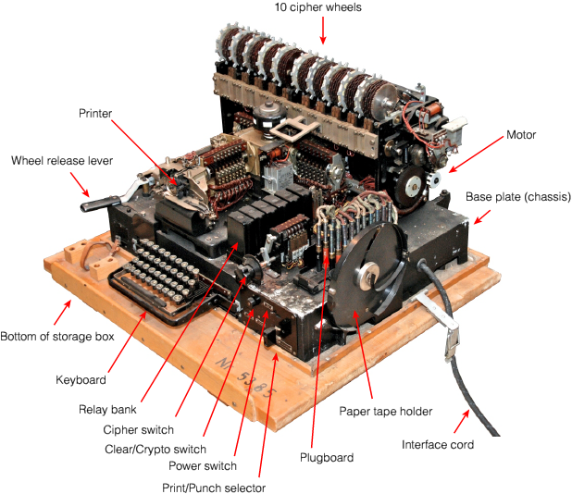
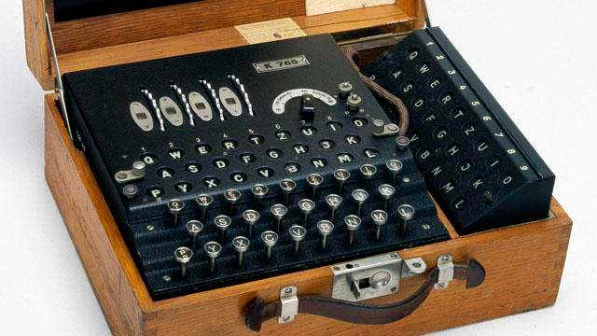
Rotor Machines

Slide 18
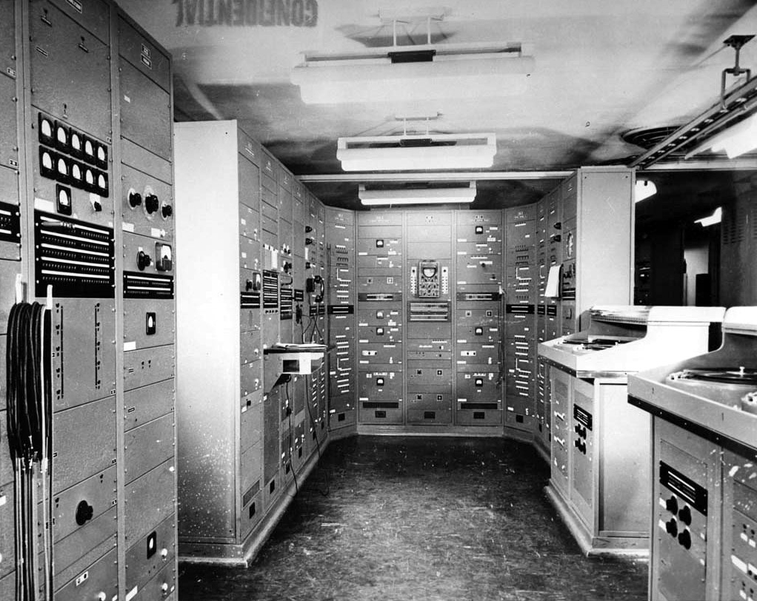
SIGSALY
https://www.nsa.gov/about/cryptologic-heritage/historical-figures-publications/publications/wwii/sigsaly-start-digital.shtml
http://www.cryptomuseum.com/crypto/usa/sigsaly/index.htm

Slide 19
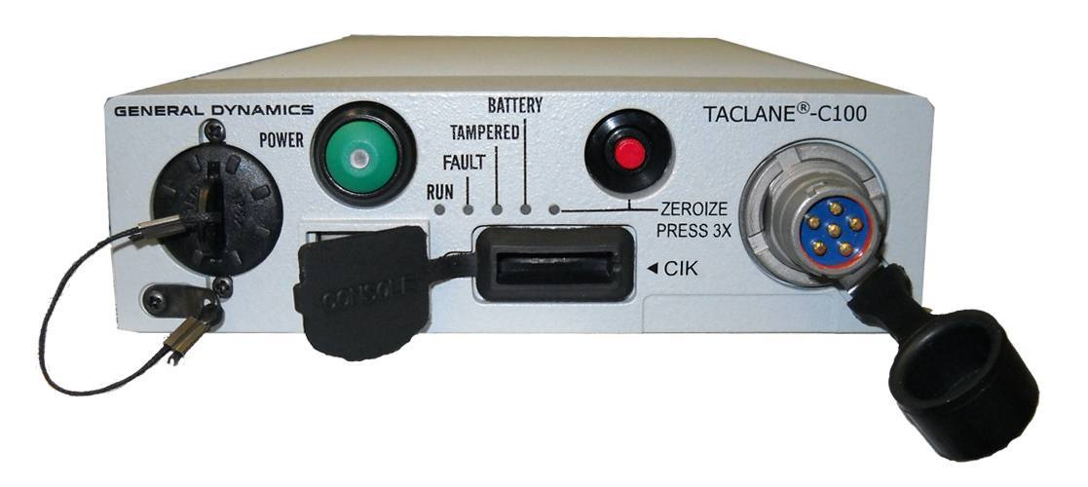
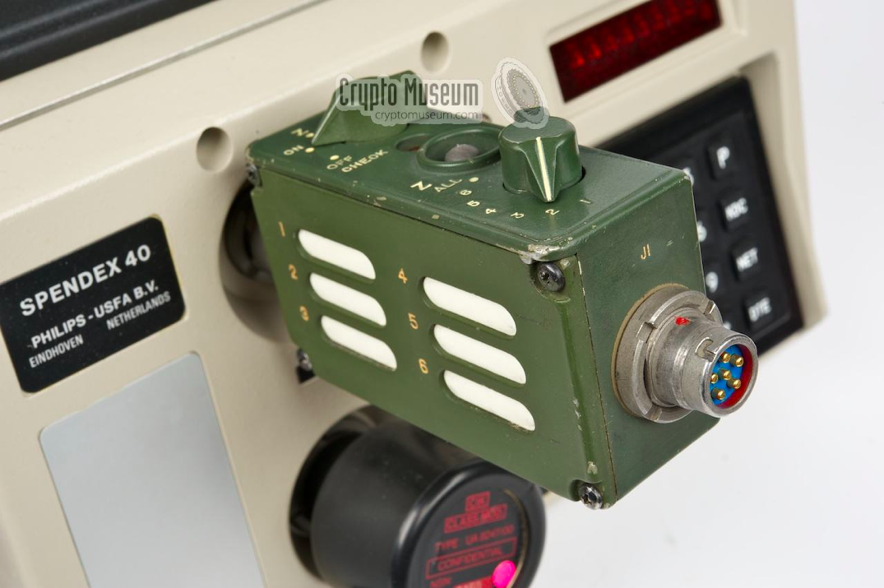
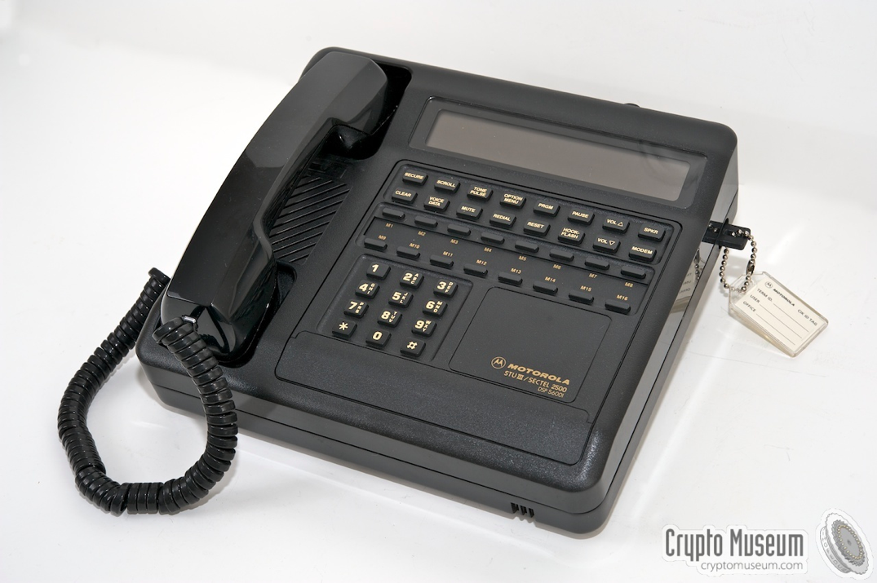
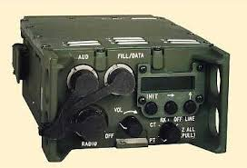
COMSEC

Slide 20
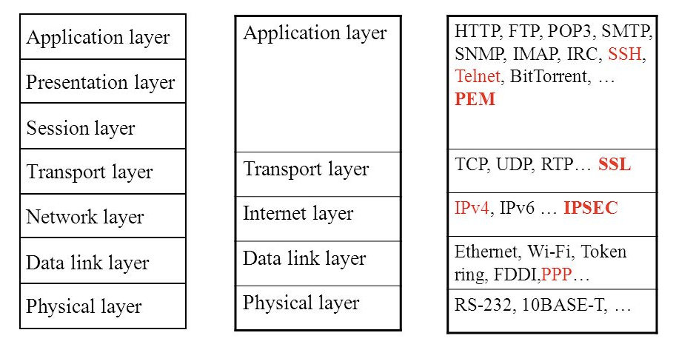
Contemporary Cryptographic Protocols
PGP, Bitcoin, DNSsec
TLS, RTP
IPsec
WPA, BT

Slide 21
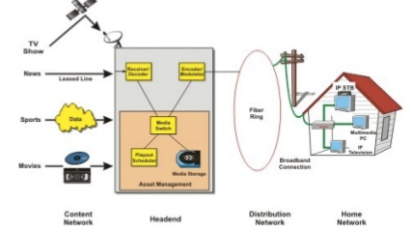
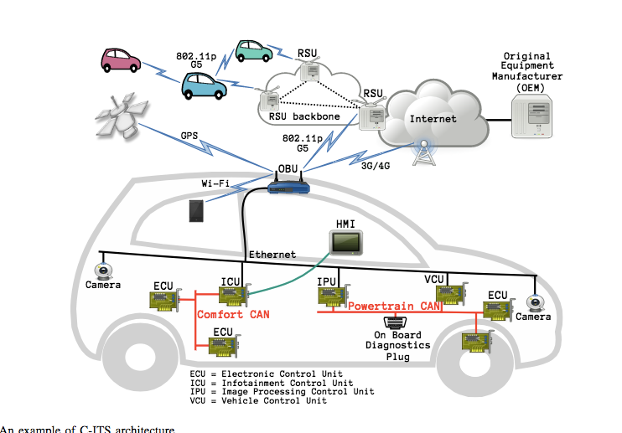
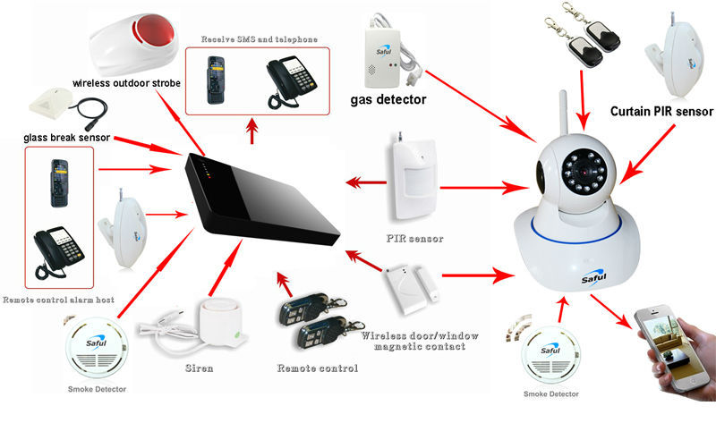
More Contemporary Cryptographic Protocols

Slide 22
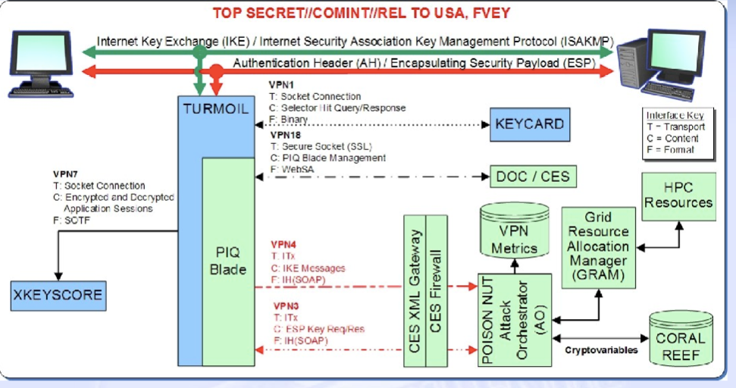
Contemporary Cryptoanalysis
https://search.edwardsnowden.com/

Slide 23
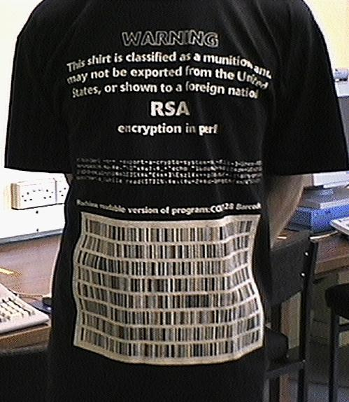
Crypto Wars

Slide 24
Cypherpunks Write Code.
The Crypto Anarchist Manifesto, Tim May, 1992
A Cypherpunk's Manifesto, Eric Hughes, 1993
Crypto Wars Timeline, Daily Dot, 2017

Slide 25






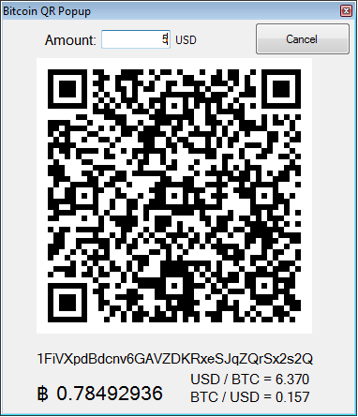


Crypto Currencies and Distributed Autonomous Organizations (DAO)
http://merkle.com/papers/DAOdemocracyDraft.pdf

Slide 26
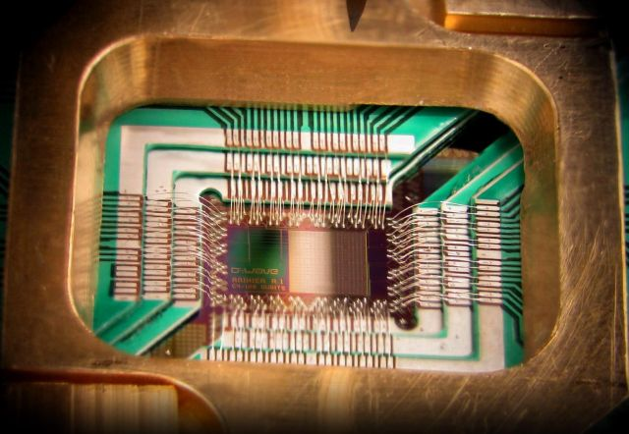
Post-Quantum Cryptography
https://arstechnica.com/information-technology/2015/08/nsa-preps-quantum-resistant-algorithms-to-head-off-crypto-apocolypse/

Slide 27
Python References
Python Documentation (Python Web Site)
Transforming Code into Beautiful, Idiomatic Python (video)

Slide 28
References
https://marshallfoundation.org/blog/friedman-collection-folger/
http://marshallfoundation.org/library/wp-content/uploads/sites/16/2014/09/WFFvol05watermark.pdf
http://marshallfoundation.org/library/wp-content/uploads/sites/16/2014/09/WFFvol06watermark.pdf
http://marshallfoundation.org/library/wp-content/uploads/sites/16/2014/09/WFFvol07watermark.pdf
http://marshallfoundation.org/library/wp-content/uploads/sites/16/2014/09/WFFvol08watermark.pdf
https://cseweb.ucsd.edu/~mihir/cse107/index.html
https://search.edwardsnowden.com/
[MTC] A Mathamatical Theory of Cryptography, Claude Shannon, 1945
[C22] Cryptography, Andre Lange, 1922 https://archive.org/details/Cryptography_593

